Slide 1



Spencer Swindell
Health Trust
PRESENTING
Building a Data Lakehouse
www.TheAnalyticsSummit.com

Slide 2
README
Live in Mount Juliet, grew up here in Nashville
Computer Science at TTU
10 years working in data and analytics
This presentation is open source! Materials for this presentation, including this presentation, can be found at https://github.com/shswindell42/Presentations/tree/main/Building%20a%20Data%20Lakehouse

Slide 3
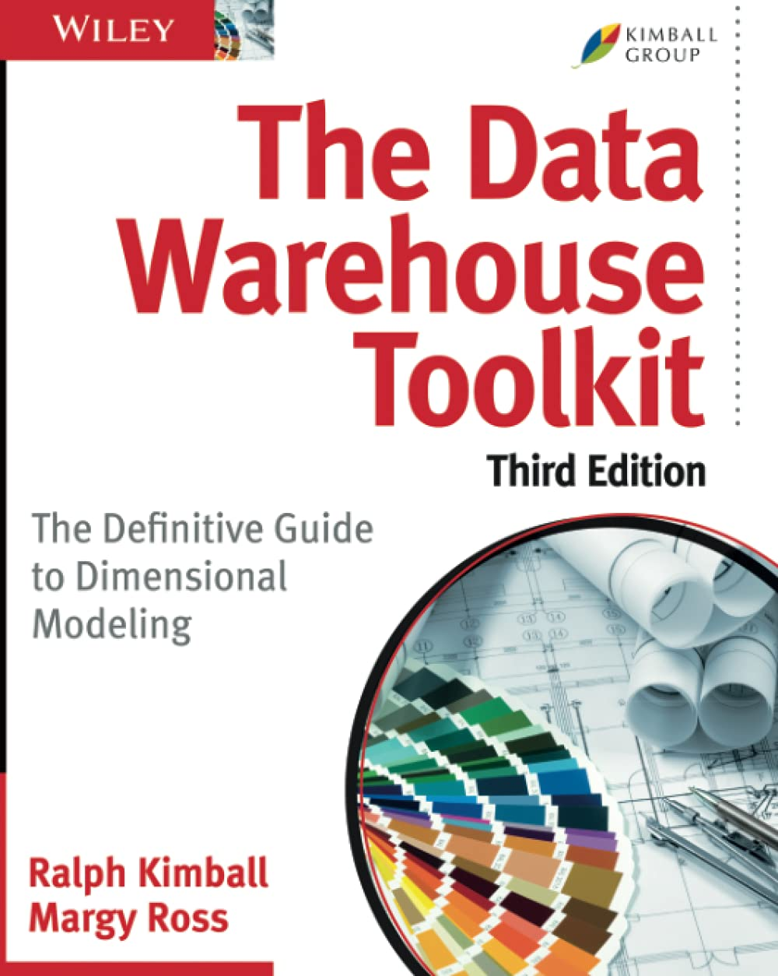
Introduction of Data Warehousing
OLTP vs OLAP
The Dimensional Model
Introduced by Ralph Kimball
See “The Data Warehouse Toolkit”
Data read into staging tables and transformed using SQL
Rigid schema on write

Slide 4
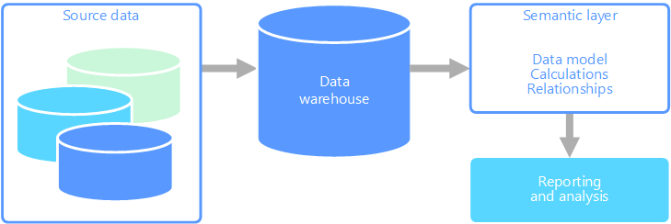
Early days of Data Warehousing

Slide 5
Introduction of the Data Lake
Data Lakes allow for more flexible storage of data
It’s just file storage!
Data first loaded into the Data Lake
Keep a copy of everything
Data copied into data warehouse system

Slide 6
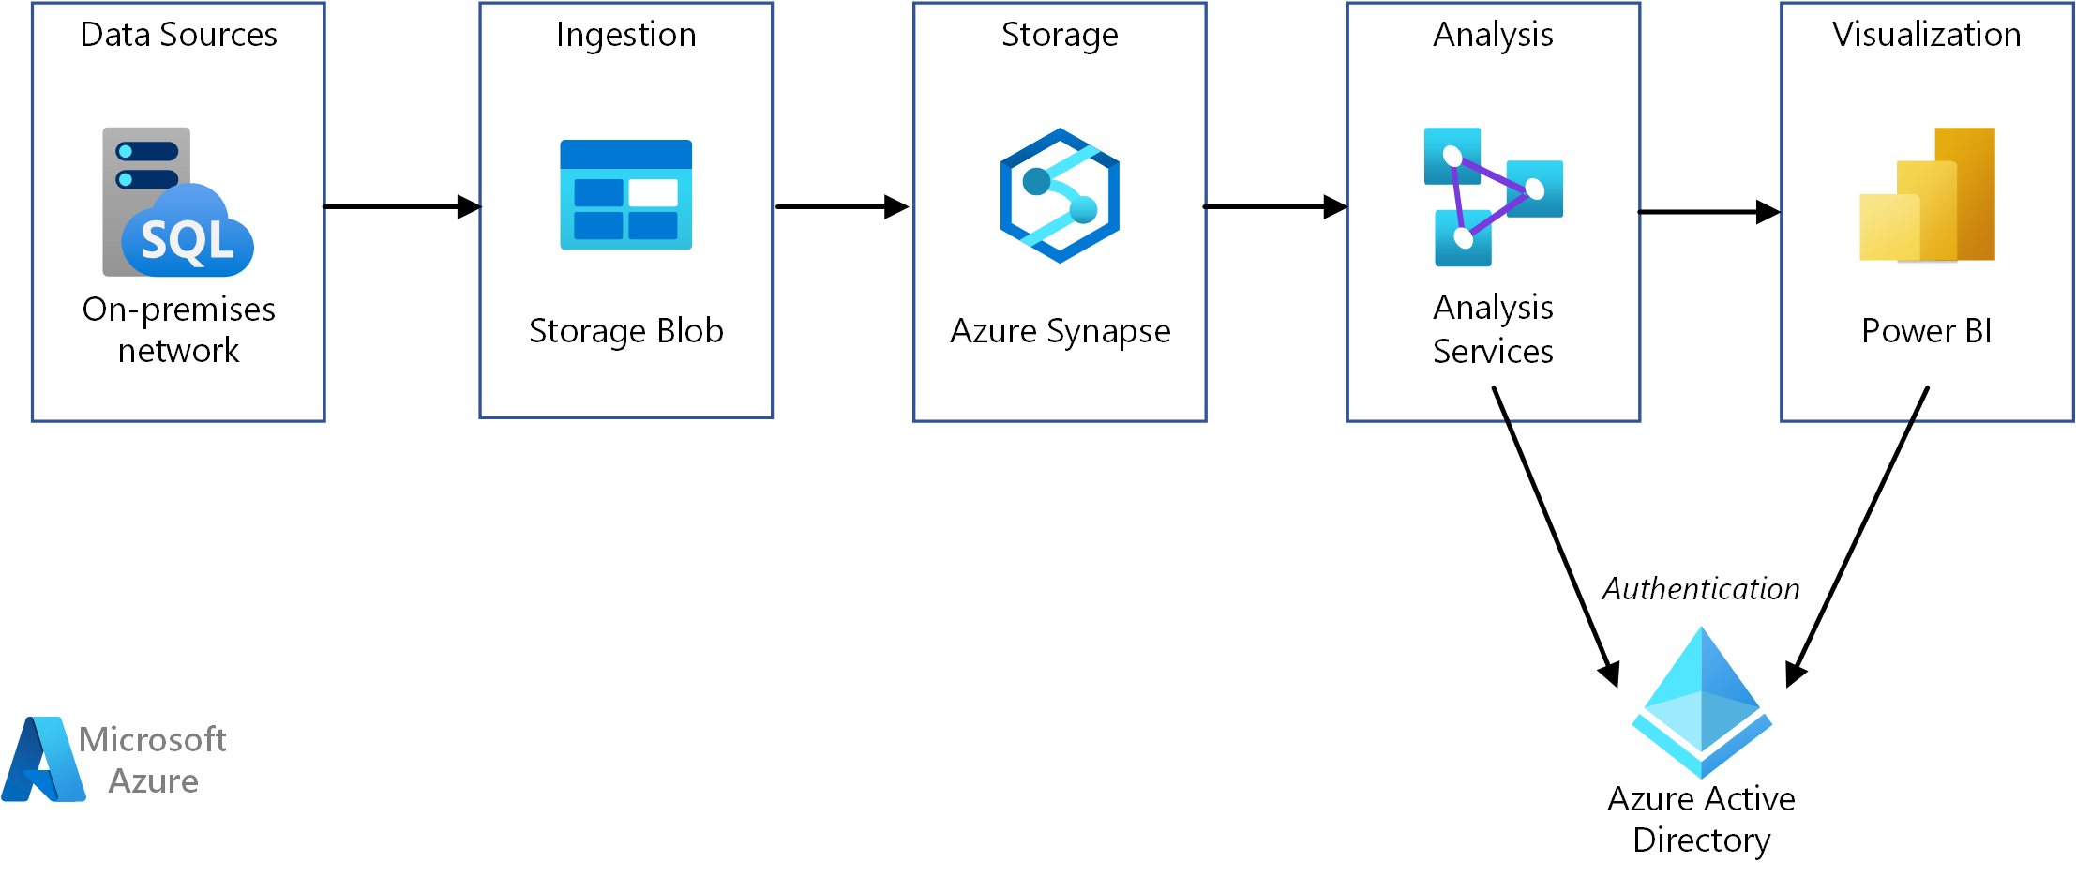
Data Warehouse with Data Lake

Slide 7
Data Lake Advantages
Separation of storage and compute
Consider the cost to keep a DW system up and running w/ little to no activity
Storage in a data lake is cheap
Turn on compute only when needed
Schema on Read
Store data in its native format, apply schema when attempting to read the data
Polyglot compute
The right tool for the right job
SQL
Spark
Custom code

Slide 8
Challenges with Data Lakes
No ability update data in place
Files have to be totally rewritten
Dependent on the compute layer to handle ACID Compliance
No native ability to recover from a crashed job
Files could get left in a corrupted state
No Consistency checks
No Isolation
A file re-write could impact other users attempting to read the data
Data Lake does handle Durability

Slide 9

Solving these challenges
Many metadata layers have come up to try and solve these problems
Apache Iceberg – https://iceberg.apache.org/
Apache Hudi - https://hudi.apache.org/
Delta Lake - https://delta.io/
We will use Delta Lake in the examples today
Delta Lake developed by Databricks
Works well with Spark
Integrations with
Azure Synapse Analytics
Snowflake
AWS Redshift

Slide 10
Delta Lake
A Delta Lake table is
A directory of data objects
These are stored as parquet files
A log of transactions and metadata
Called _delta_log
Json files, with checkpoints as parquet files
The data objects are immutable
The log tracks which files belong to which “version” of the table

Slide 11
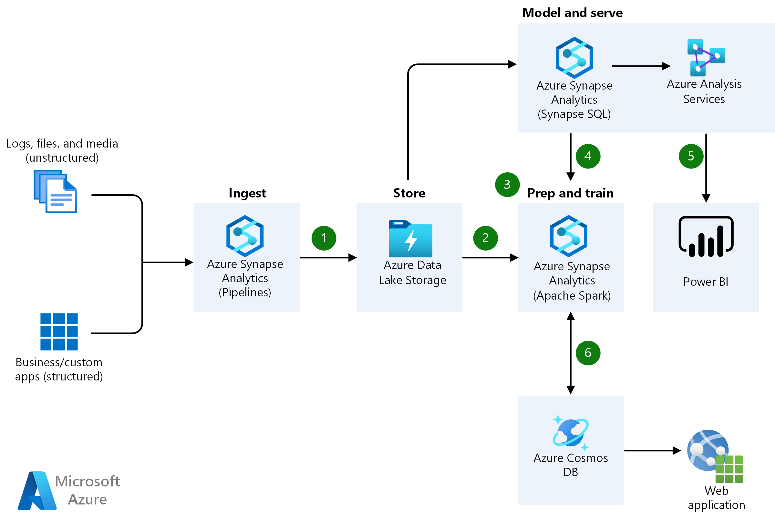

Slide 12
Related Resources
Data Warehouse Toolkit
Lakehouse Whitepaper - https://www.cidrdb.org/cidr2021/papers/cidr2021_paper17.pdf
Delta Lake whitepaper - https://www.databricks.com/wp-content/uploads/2020/08/p975-armbrust.pdf
Azure Architectures
https://docs.microsoft.com/en-us/azure/architecture/reference-architectures/data/enterprise-bi-synapse
https://docs.microsoft.com/en-us/azure/architecture/data-guide/relational-data/online-analytical-processing
https://docs.microsoft.com/en-us/azure/architecture/solution-ideas/articles/advanced-analytics-on-big-data

